Slide 1
Collections in Java

Slide 2
Collections in Java
The Collection in Java is a framework that provides an architecture to store and manipulate the group of objects.
Java Collections can achieve all the operations that you perform on a data such as searching, sorting, insertion, manipulation, and deletion.
Java Collection means a single unit of objects. Java Collection framework provides many interfaces (Set, List, Queue, Deque) and classes (ArrayList
Vector, LinkedList
PriorityQueue
HashSet, LinkedHashSet, TreeSet).

Slide 3
What is Collection in Java
A Collection represents a single unit of objects, i.e., a group.

Slide 4
What is a framework in Java
It provides readymade architecture.
It represents a set of classes and interfaces.
It is optional.

Slide 5
What is Collection framework
The Collection framework represents a unified architecture for storing and manipulating a group of objects. It has:
Interfaces and its implementations, i.e., classes
Algorithm

Slide 6
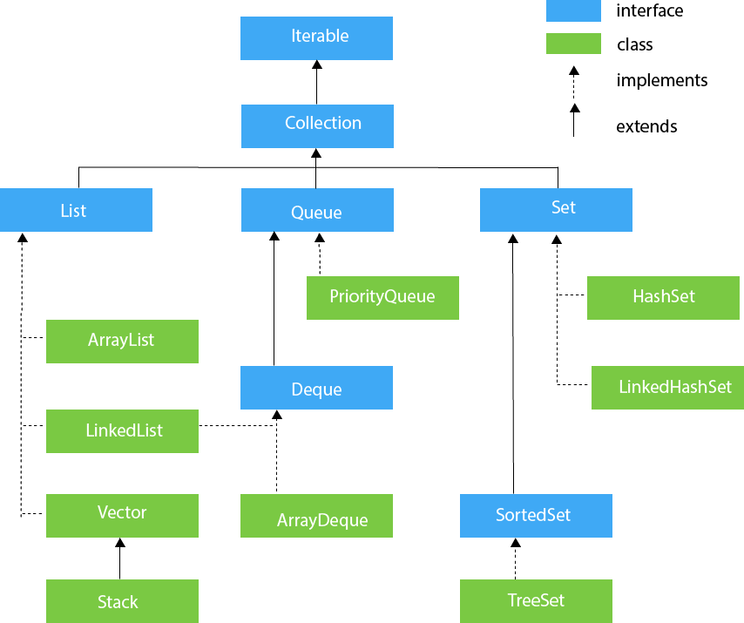
Hierarchy of Collection Framework

Slide 7
Methods of Collection interface
here are many methods declared in the Collection interface. They are as follows:
No. | Method | Description
1 | public boolean add(E e) | It is used to insert an element in this collection.
2 | public boolean addAll(Collection<? extends E> c) | It is used to insert the specified collection elements in the invoking collection.
3 | public boolean remove(Object element) | It is used to delete an element from the collection.
4 | public boolean removeAll(Collection<?> c) | It is used to delete all the elements of the specified collection from the invoking collection.
5 | default boolean removeIf(Predicate<? super E> filter) | It is used to delete all the elements of the collection that satisfy the specified predicate.
6 | public boolean retainAll(Collection<?> c) | It is used to delete all the elements of invoking collection except the specified collection.

Slide 8
Continue
7 | public int size() | It returns the total number of elements in the collection.
8 | public void clear() | It removes the total number of elements from the collection.
9 | public boolean contains(Object element) | It is used to search an element.
10 | public boolean containsAll(Collection<?> c) | It is used to search the specified collection in the collection.
11 | public Iterator iterator() | It returns an iterator.
12 | public Object[] toArray() | It converts collection into array.
13 | public <T> T[] toArray(T[] a) | It converts collection into array. Here, the runtime type of the returned array is that of the specified array.
14 | public boolean isEmpty() | It checks if collection is empty.

Slide 9
continue
15 | default Stream<E> parallelStream() | It returns a possibly parallel Stream with the collection as its source.
16 | default Stream<E> stream() | It returns a sequential Stream with the collection as its source.
17 | default Spliterator<E> spliterator() | It generates a Spliterator over the specified elements in the collection.
18 | public boolean equals(Object element) | It matches two collections.
19 | public int hashCode() | It returns the hash code number of the collection.

Slide 10
Iterator interface
Iterator interface provides the facility of iterating the elements in a forward direction only.
No. | Method | Description
1 | public boolean hasNext() | It returns true if the iterator has more elements otherwise it returns false.
2 | public Object next() | It returns the element and moves the cursor pointer to the next element.
3 | public void remove() | It removes the last elements returned by the iterator. It is less used.

Slide 11
List Interface
List interface is the child interface of Collection interface. It inhibits a list type data structure in which we can store the ordered collection of objects. It can have duplicate values.
List interface is implemented by the classes ArrayList, LinkedList, Vector, and Stack.
To instantiate the List interface, we must use :
List <data-type> list1= new ArrayList();
List <data-type> list2 = new LinkedList();
List <data-type> list3 = new Vector();
List <data-type> list4 = new Stack();

Slide 12
ArrayList
The ArrayList class implements the List interface. It uses a dynamic array to store the duplicate element of different data types. The ArrayList class maintains the insertion order and is non-synchronized. The elements stored in the ArrayList class can be randomly accessed.

Slide 13
import java.util.*;
class TestJavaCollection1{
public static void main(String args[]){
ArrayList<String> list=new ArrayList<String>();//Creating arraylist
list.add("Ravi");//Adding object in arraylist
list.add("Vijay");
list.add("Ravi");
list.add("Ajay");
//Traversing list through Iterator
Iterator itr=list.iterator();
while(itr.hasNext()){
System.out.println(itr.next());
}
}
}
Output:
Ravi
Vijay
Ravi
Ajay

Slide 14
LinkedList
LinkedList implements the Collection interface. It uses a doubly linked list internally to store the elements. It can store the duplicate elements. It maintains the insertion order and is not synchronized. In LinkedList, the manipulation is fast because no shifting is required.

Slide 15
import java.util.*;
public class TestJavaCollection2{
public static void main(String args[]){
LinkedList<String> al=new LinkedList<String>();
al.add("Ravi");
al.add("Vijay");
al.add("Ravi");
al.add("Ajay");
Iterator<String> itr=al.iterator();
while(itr.hasNext()){
System.out.println(itr.next());
}
}
}
Output:
Ravi
Vijay
Ravi
Ajay

Slide 16
Vector
Vector uses a dynamic array to store the data elements. It is similar to ArrayList. However, It is synchronized and contains many methods that are not the part of Collection framework.

Slide 17
import java.util.*;
public class TestJavaCollection3{
public static void main(String args[]){
Vector<String> v=new Vector<String>();
v.add("Ayush");
v.add("Amit");
v.add("Ashish");
v.add("Garima");
Iterator<String> itr=v.iterator();
while(itr.hasNext()){
System.out.println(itr.next());
}
}
}
Output:
Ayush
Amit
Ashish
Garima

Slide 18
Stack
The stack is the subclass of Vector. It implements the last-in-first-out data structure, i.e., Stack. The stack contains all of the methods of Vector class and also provides its methods like boolean push(), boolean peek(), boolean push(object o), which defines its properties.

Slide 19
import java.util.*;
public class TestJavaCollection4{
public static void main(String args[]){
Stack<String> stack = new Stack<String>();
stack.push("Ayush");
stack.push("Garvit");
stack.push("Amit");
stack.push("Ashish");
stack.push("Garima");
stack.pop();
Iterator<String> itr=stack.iterator();
while(itr.hasNext()){
System.out.println(itr.next());
}
}
}
Output
Ayush
Garvit
Amit
Ashish

Slide 20
Queue Interface
Queue interface maintains the first-in-first-out order. It can be defined as an ordered list that is used to hold the elements which are about to be processed. There are various classes like PriorityQueue, Deque, and ArrayDeque which implements the Queue interface.
Queue interface can be instantiated as:
Queue<String> q1 = new PriorityQueue();
Queue<String> q2 = new ArrayDeque();

Slide 21
PriorityQueue
The PriorityQueue class implements the Queue interface. It holds the elements or objects which are to be processed by their priorities. PriorityQueue doesn't allow null values to be stored in the queue.

Slide 22
import java.util.*;
public class TestJavaCollection5{
public static void main(String args[]){
PriorityQueue<String> queue=new PriorityQueue<String>();
queue.add("Amit Sharma");
queue.add("Vijay Raj");
queue.add("JaiShankar");
queue.add("Raj");
System.out.println("head:"+queue.element());
System.out.println("head:"+queue.peek());
System.out.println("iterating the queue elements:");
Iterator itr=queue.iterator();
while(itr.hasNext()){
System.out.println(itr.next());
}
queue.remove();
queue.poll();
System.out.println("after removing two elements:");
Iterator<String> itr2=queue.iterator();
while(itr2.hasNext()){
System.out.println(itr2.next());
}
}
}
Output:
head:Amit Sharma
head:Amit Sharma
iterating the queue elements: Amit Sharma
Raj JaiShankar
Vijay Raj
after removing two elements: Raj
Vijay Raj

Slide 23
Deque Interface
Deque interface extends the Queue interface. In Deque, we can remove and add the elements from both the side. Deque stands for a double-ended queue which enables us to perform the operations at both the ends.
Deque can be instantiated as:
Deque d = new ArrayDeque();

Slide 24
ArrayDeque
ArrayDeque class implements the Deque interface. It facilitates us to use the Deque. Unlike queue, we can add or delete the elements from both the ends.
ArrayDeque is faster than ArrayList and Stack and has no capacity restrictions.

Slide 25
import java.util.*;
public class TestJavaCollection6{
public static void main(String[] args) {
//Creating Deque and adding elements
Deque<String> deque = new ArrayDeque<String>();
deque.add("Gautam");
deque.add("Karan");
deque.add("Ajay");
//Traversing elements
for (String str : deque) {
System.out.println(str);
}
}
}
Output:
Gautam
Karan
Ajay

Slide 26
Set Interface
Set Interface in Java is present in java.util package. It extends the Collection interface. It represents the unordered set of elements which doesn't allow us to store the duplicate items. We can store at most one null value in Set. Set is implemented by HashSet, LinkedHashSet, and TreeSet.
Set can be instantiated as:
Set<data-type> s1 = new HashSet<data-type>();
Set<data-type> s2 = new LinkedHashSet<data-type>();
Set<data-type> s3 = new TreeSet<data-type>();

Slide 27
HashSet
HashSet class implements Set Interface. It represents the collection that uses a hash table for storage. Hashing is used to store the elements in the HashSet. It contains unique items.

Slide 28
import java.util.*;
public class TestJavaCollection7{
public static void main(String args[]){
//Creating HashSet and adding elements
HashSet<String> set=new HashSet<String>();
set.add("Ravi");
set.add("Vijay");
set.add("Ravi");
set.add("Ajay");
//Traversing elements
Iterator<String> itr=set.iterator();
while(itr.hasNext()){
System.out.println(itr.next());
}
}
}
Output:
Vijay
Ravi
Ajay

Slide 29
LinkedHashSet
LinkedHashSet class represents the LinkedList implementation of Set Interface. It extends the HashSet class and implements Set interface. Like HashSet, It also contains unique elements. It maintains the insertion order and permits null elements.

Slide 30
import java.util.*;
public class TestJavaCollection8{
public static void main(String args[]){
LinkedHashSet<String> set=new LinkedHashSet<String>();
set.add("Ravi");
set.add("Vijay");
set.add("Ravi");
set.add("Ajay");
Iterator<String> itr=set.iterator();
while(itr.hasNext()){
System.out.println(itr.next());
}
}
}
Output:
Ravi
Vijay
Ajay

Slide 31
TreeSet
Java TreeSet class implements the Set interface that uses a tree for storage. Like HashSet, TreeSet also contains unique elements. However, the access and retrieval time of TreeSet is quite fast. The elements in TreeSet stored in ascending order.

Slide 32
import java.util.*;
public class TestJavaCollection9{
public static void main(String args[]){
//Creating and adding elements
TreeSet<String> set=new TreeSet<String>();
set.add("Ravi");
set.add("Vijay");
set.add("Ravi");
set.add("Ajay");
//traversing elements
Iterator<String> itr=set.iterator();
while(itr.hasNext()){
System.out.println(itr.next());
}
}
}
Output:
Ajay
Ravi
Vijay

Slide 33
Java Queue Interface
Java Queue interface orders the element in FIFO(First In First Out) manner. In FIFO, first element is removed first and last element is removed at last.

Slide 34
PriorityQueue class
The PriorityQueue class provides the facility of using queue. But it does not orders the elements in FIFO manner. It inherits AbstractQueue class.
PriorityQueue class declaration
public class PriorityQueue<E> extends AbstractQueue<E> implements Serializable

Slide 35
mport java.util.*;
class TestCollection12{
public static void main(String args[]){
PriorityQueue<String> queue=new PriorityQueue<String>();
queue.add("Amit");
queue.add("Vijay");
queue.add("Karan");
queue.add("Jai");
queue.add("Rahul");
System.out.println("head:"+queue.element());
System.out.println("head:"+queue.peek());
System.out.println("iterating the queue elements:");
Iterator itr=queue.iterator();
while(itr.hasNext()){
System.out.println(itr.next());
}
queue.remove();
queue.poll();
System.out.println("after removing two elements:");
Iterator<String> itr2=queue.iterator();
while(itr2.hasNext()){
System.out.println(itr2.next());
}
}
}
Output:
head:Amit
head:Amit
iterating the queue elements:
Amit
Jai
Karan
Vijay
Rahul
after removing two elements:
Karan
Rahul
Vijay

Slide 36
Java Comparator interface
Java Comparator interface is used to order the objects of a user-defined class.
This interface is found in java.util package and contains 2 methods compare(Object obj1,Object obj2) and equals(Object element).
It provides multiple sorting sequences, i.e., you can sort the elements on the basis of any data member, for example, rollno, name, age or anything else.

Slide 37
Methods of Java Comparator Interface
Method | Description
public int compare(Object obj1, Object obj2) | It compares the first object with the second object.
public boolean equals(Object obj) | It is used to compare the current object with the specified object.
public boolean equals(Object obj) | It is used to compare the current object with the specified object.

Slide 38
Comparable interface in java
Comparable interface is used to sort Java objects using data members of the user-defined class and this interface is located in the java.lang package, if we want to sort any member data of the class then this class must implement the Comparable interface. This interface has only one method which we have to override compareTo(Object obj).

Slide 39
Sr. No. | Key | Comparable | Comparator
1 | Methods | The comparable interface has a method compareTo(Object a ) | The comparator has a method compare(Object o1, Object O2)
2 | Sorting uses | Collection.sort(List) method can be used to sort the collection of Comparable type objects. | Collection.sort(List, Comparator) method can be used to sort the collection of Comparator type objects.
3 | Sorting sequence | Comparable provides single sorting sequence. | The comparator provides a multiple sorting sequence.
4 | Package | Comparable interface belongs to java.lang package. | Comparator interface belongs to java.util package.

Slide 40
Properties class in Java
The properties object contains key and value pair both as a string. The java.util.Properties class is the subclass of Hashtable.
It can be used to get property value based on the property key. The Properties class provides methods to get data from the properties file and store data into the properties file. Moreover, it can be used to get the properties of a system.

Slide 41
An Advantage of the properties file
Recompilation is not required if the information is changed from a properties file:
If any information is changed from the properties file, you don't need to recompile the java class. It is used to store information which is to be changed frequently.

Slide 42
Constructors of Properties class
Method | Description
Properties() | It creates an empty property list with no default values.
Properties(Properties defaults) | It creates an empty property list with the specified defaults.

Slide 43
Java Lambda Expressions
Lambda expression is a new and important feature of Java which was included in Java SE 8. It provides a clear and concise way to represent one method interface using an expression. It is very useful in collection library. It helps to iterate, filter and extract data from collection.
The Lambda expression is used to provide the implementation of an interface which has functional interface. It saves a lot of code. In case of lambda expression, we don't need to define the method again for providing the implementation. Here, we just write the implementation code.

Slide 44
Why use Lambda Expression
To provide the implementation of Functional interface.
Less coding.
Java Lambda Expression Syntax
argument-list) -> {body}

Slide 45
Continue
Java lambda expression is consisted of three components.
1) Argument-list: It can be empty or non-empty as well.
2) Arrow-token: It is used to link arguments-list and body of expression.
3) Body: It contains expressions and statements for lambda expression.

Slide 46
continue
No Parameter Syntax
() -> {
//Body of no parameter lambda
}
One Parameter Syntax
(p1) -> {
//Body of single parameter lambda
}
Two Parameter Syntax
(p1,p2) -> {
//Body of multiple parameter lambda
}

